Slide 1
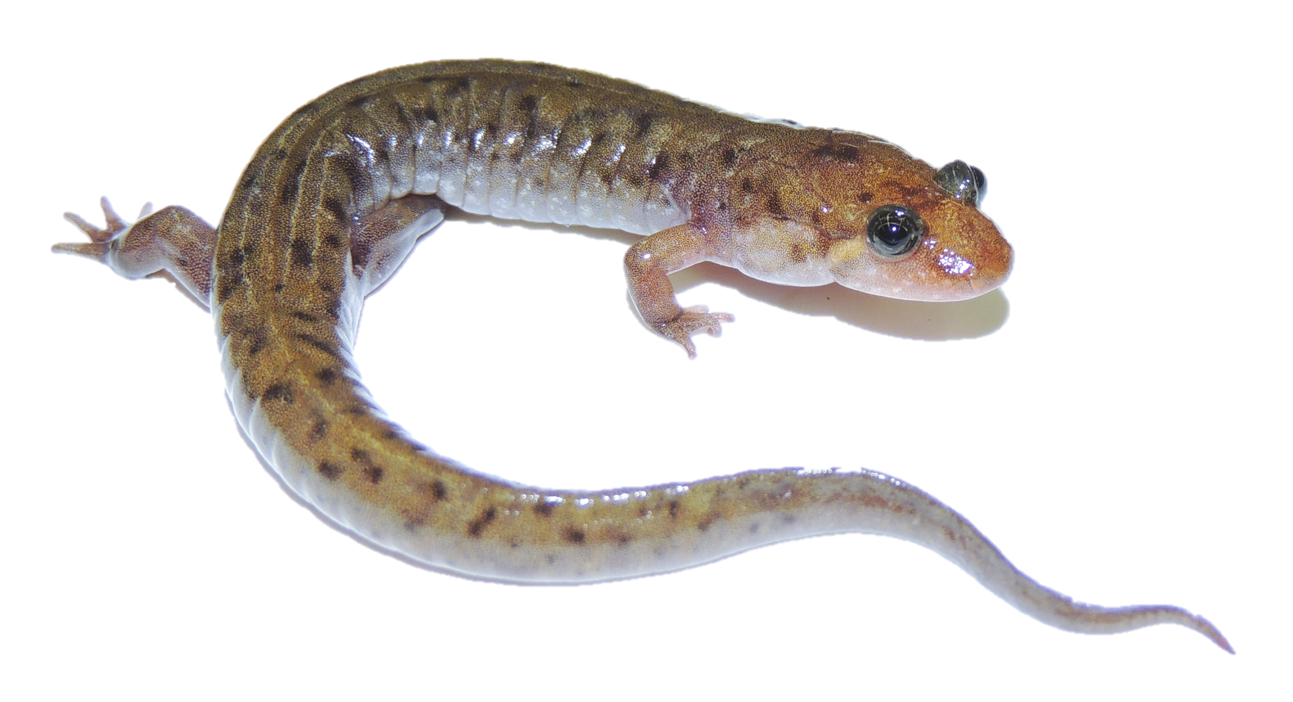
EDGE Values and Conservation Priority in Salamandridae
William Sano

Slide 2
Sixth Mass Extinction
Five historic mass extinctions in world history
Extinction rates exceeding 75% of all species (Barnosky 2011)
Climate change and other anthropogenic factors may be driving another
“The Anthropocene Extinction”
Amphibians particularly at risk
roughly half of all 6,300 species threatened by extinction (Wake 2008)
Need a way to determine which species are most important to conserve
level of endangerment, ecosystem services, charisma

Slide 3
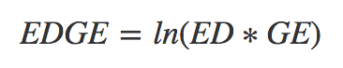
Isaac et al 2007 and EDGE Values
metric for phylogenetically informed conservation
Prevent the loss of phylogenetic diversity by conserving evolutionarily distinct (ED) and globally endangered (GE) species

Slide 4
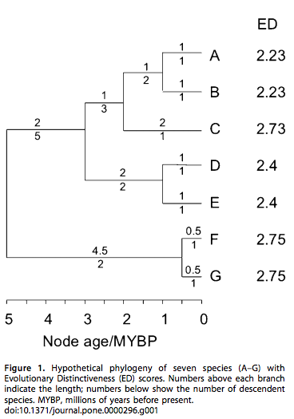
ED Evolutionarily Distinct
sum of branch length from the root
captures taxa’s unique evolutionary history
branch lengths contribute less if shared by multiple taxa
calculated by caper
Isaac et al 2007

Slide 5
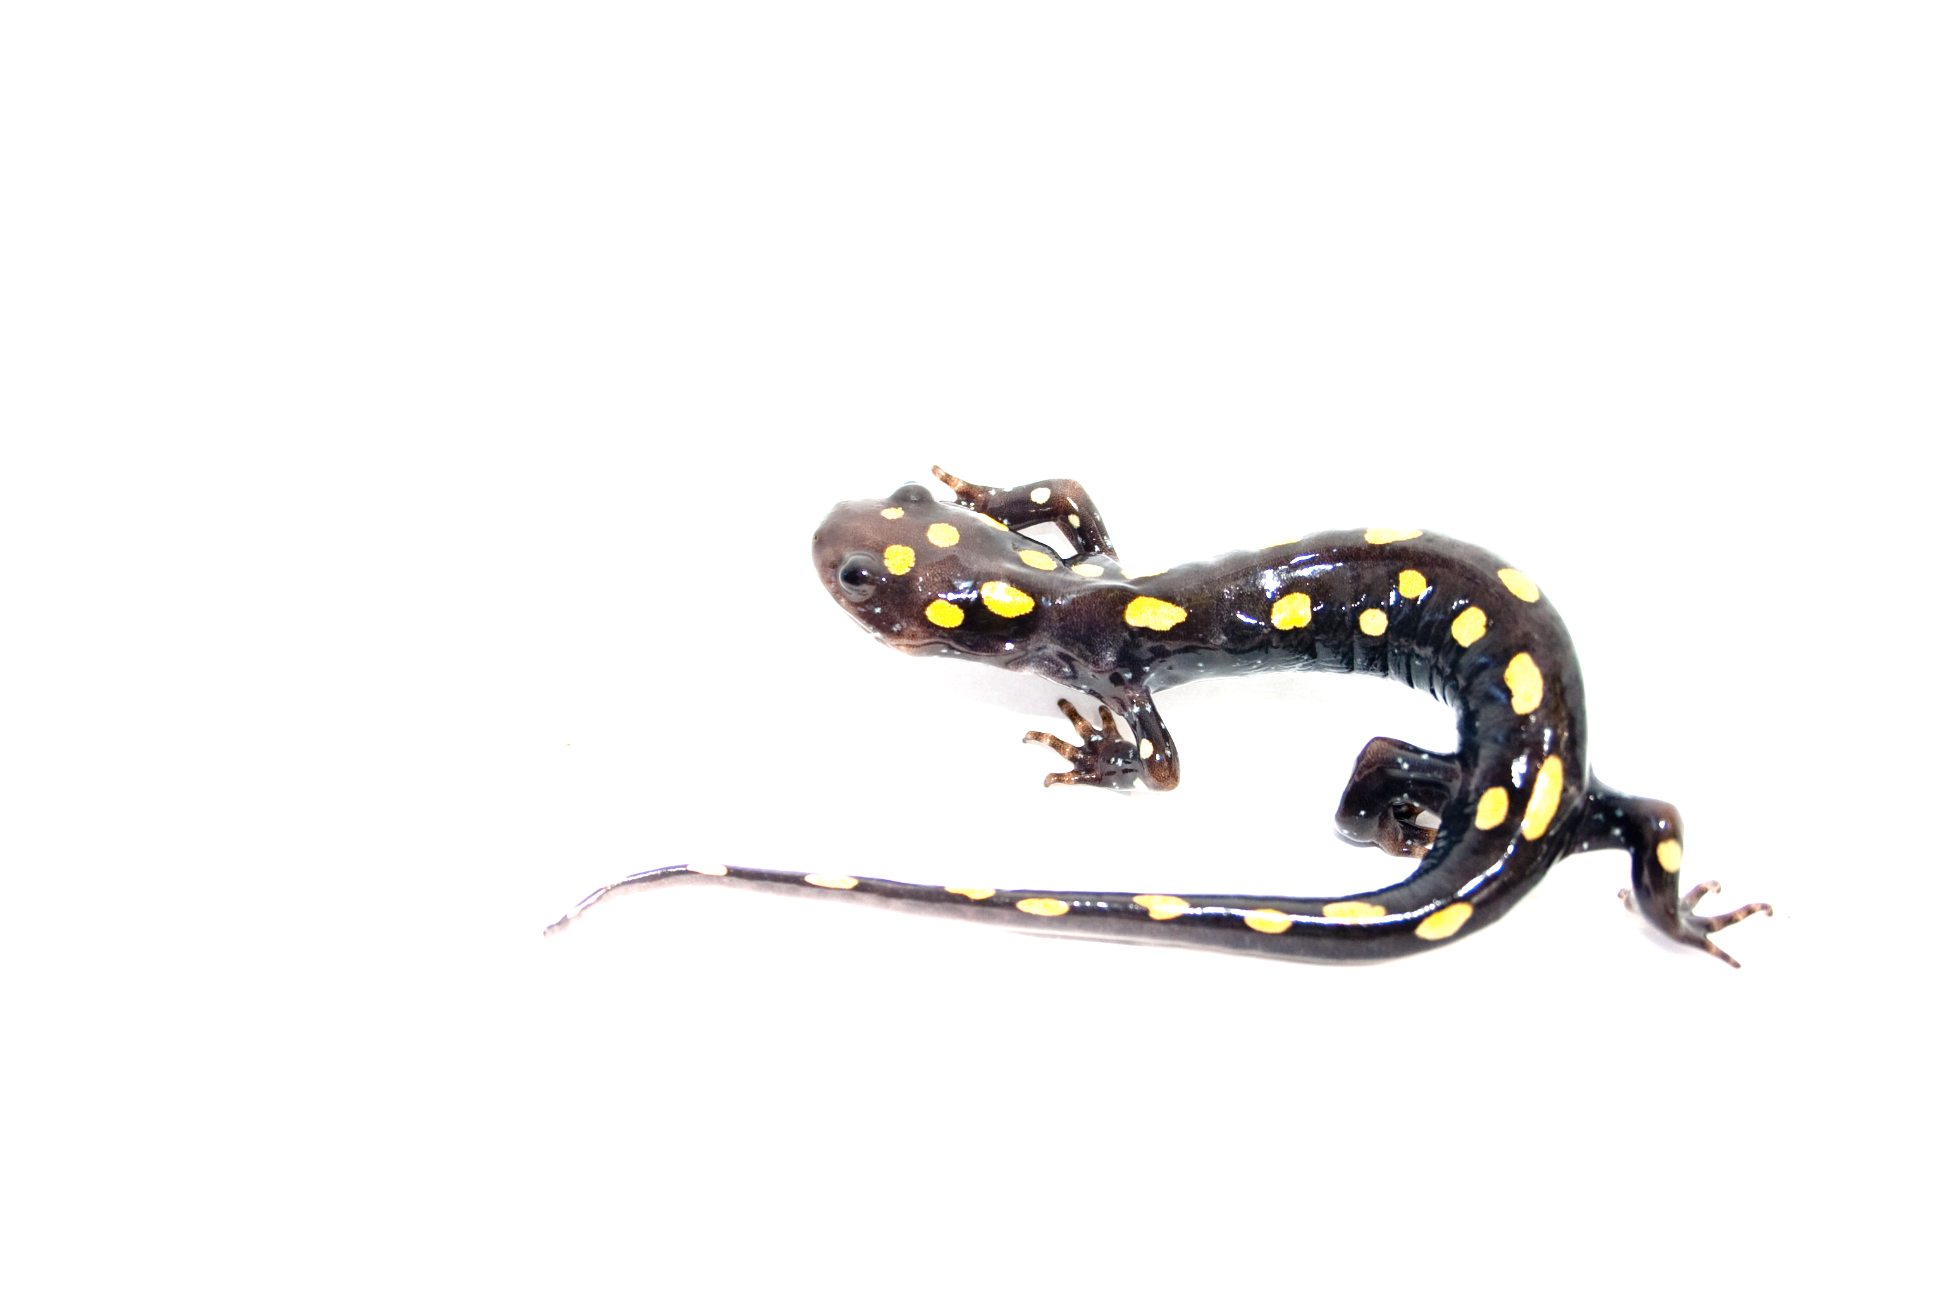
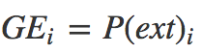
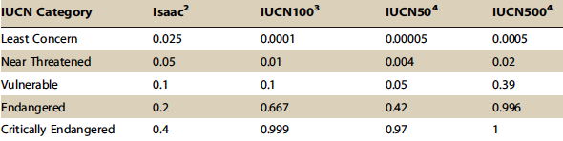
GE Globally Endangered
Transform the five IUCN Red List categories into P(ext)
Data Deficient (DD) species not included
Mooers et al 2008

Slide 6
Goal:
Investigate the role of GE parameters on EDGE value-based conservation priority rankings among salamanders

Slide 7
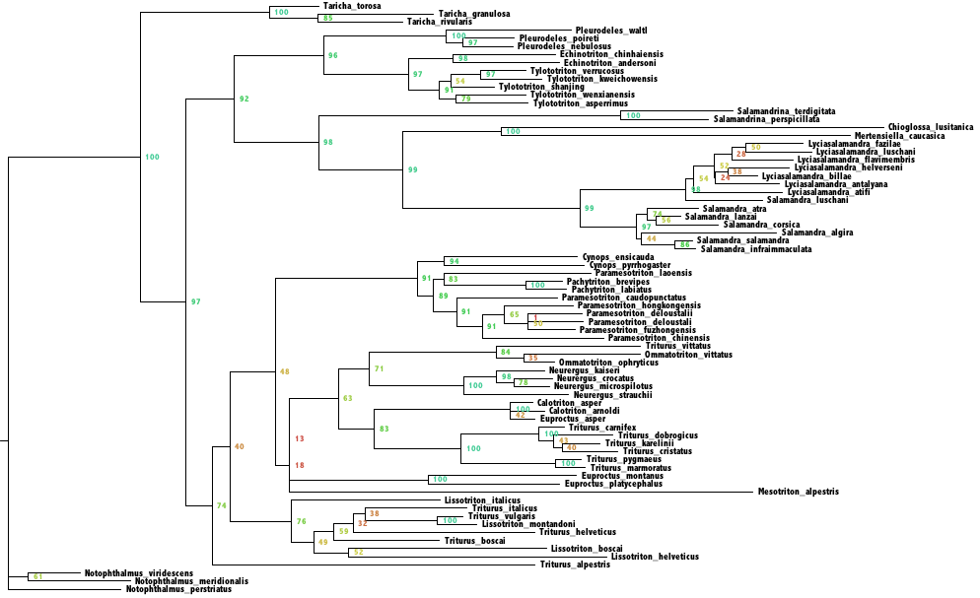
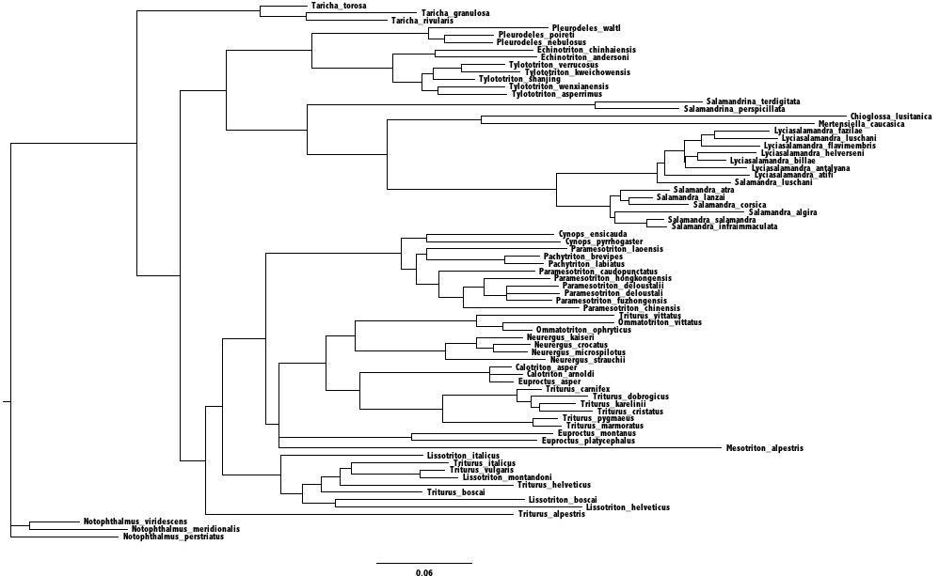
Salamandridae Phylogeny
data: Pyron 2011, IUCN

Slide 8
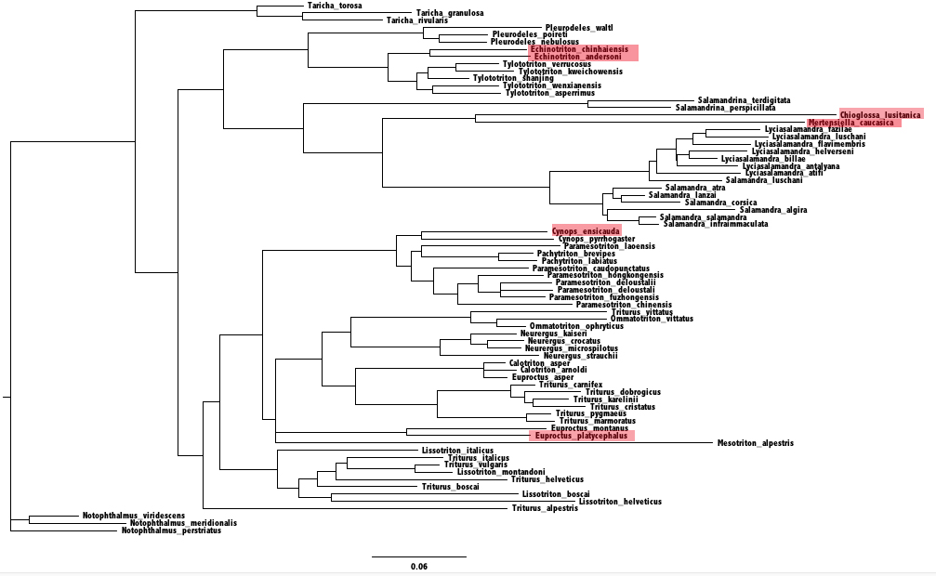
highest EDGE values

Slide 9
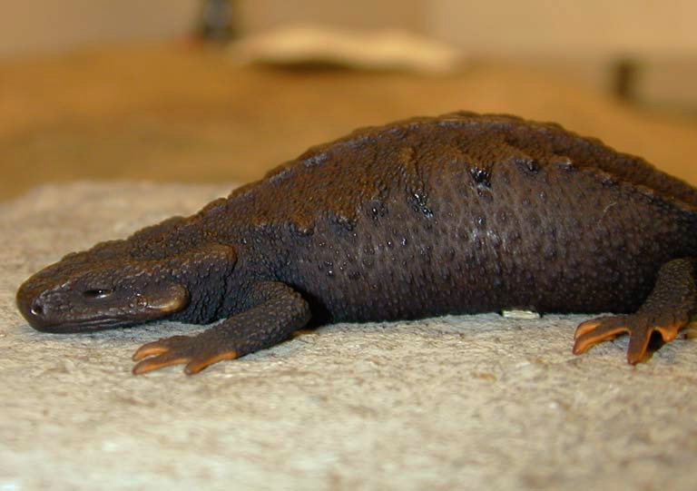
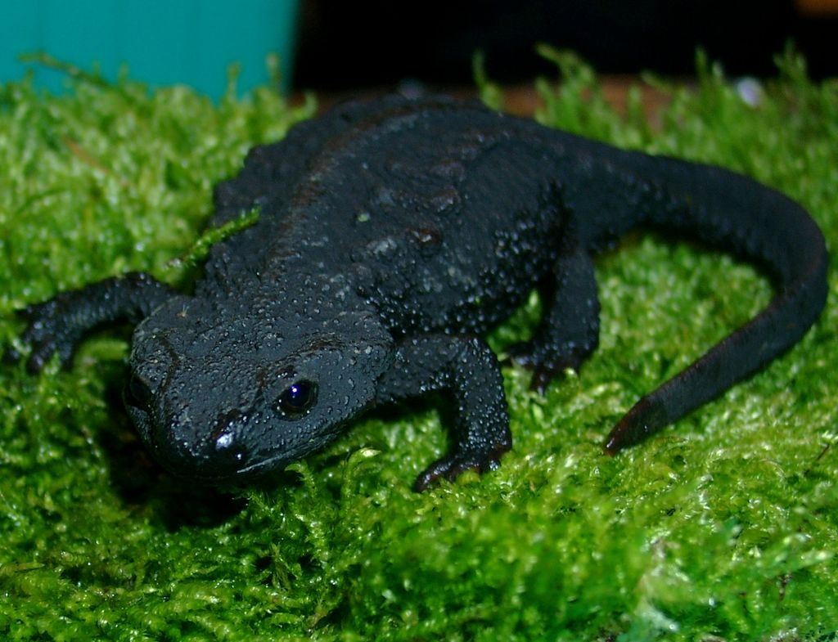
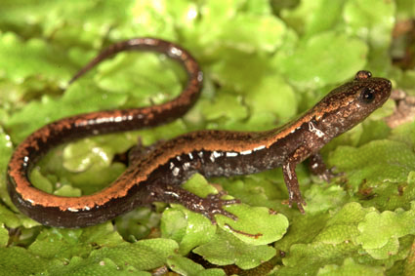
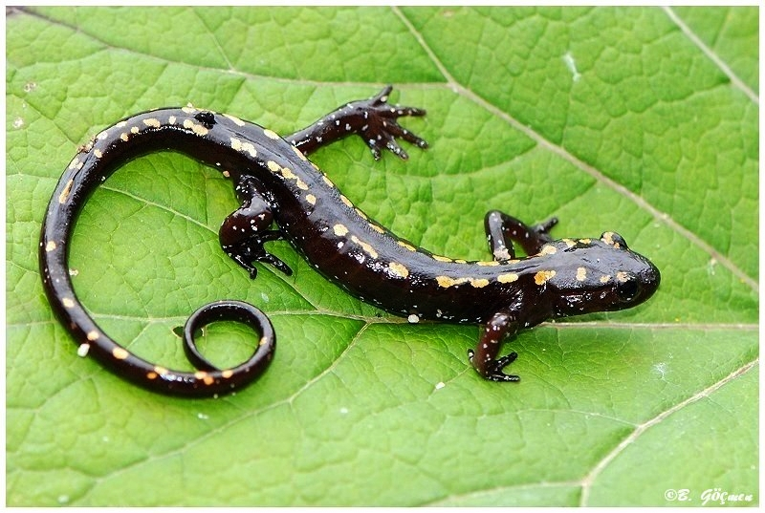
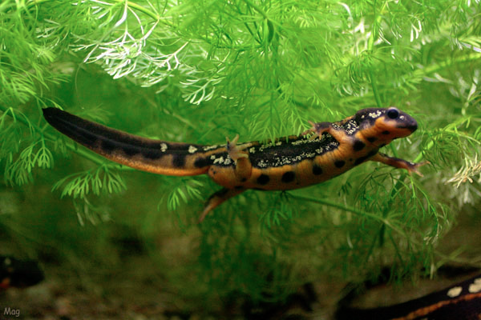
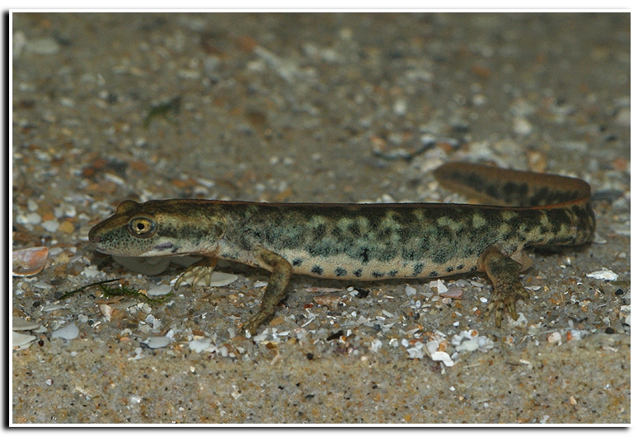
Echinotriton chianensis
Echinotriton andersoni
Chinhai spiny newt (CR)
Anderson’s crocodile newt (EN)
Chioglossa lusitanica
Mertensiella caucasica
Gold-striped salamander (VU)
Caucasian salamander (VU)
Cynops ensicauda
Euproctus platycephalus
Sword-tail newt (EN)
Sardinian brook salamander (EN)
Notes:
Echinotritons – collected for pet trade
Chioglossa lusitanica – only vulnerable, but the only one of its genus
Mertensiella caucasica – extensive logging in Georgia, no protected habitat
Cynops ensicauda – highly territorial, breeding sights diminishing
Euproctus platycephalus – found only in Sardinia

Slide 10
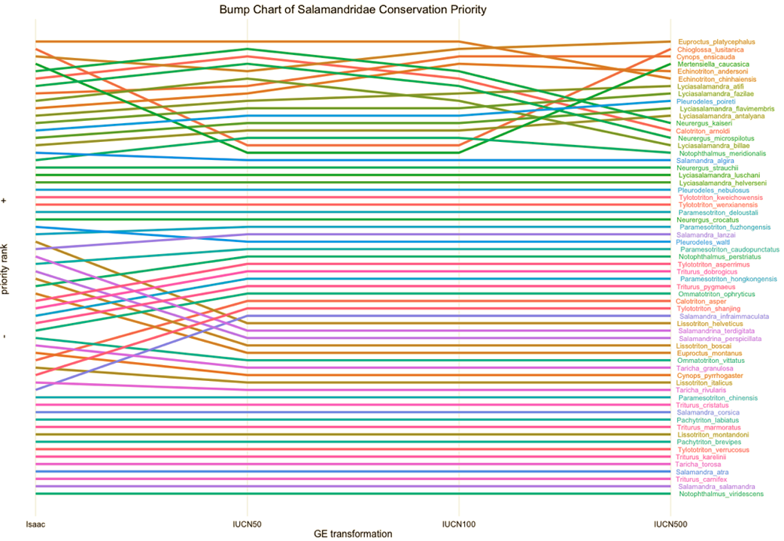
Bump Chart of Salamandridae Conservation Priority (EDGE)

Slide 11
Conclusions
Priority rank changes with IUCN rank transformation model
Highest ranking taxa in EDGE-based conservation priority list for Salamandridae are the least stable across lists
Cause for reconsideration or more study of the EDGE metric

Slide 12
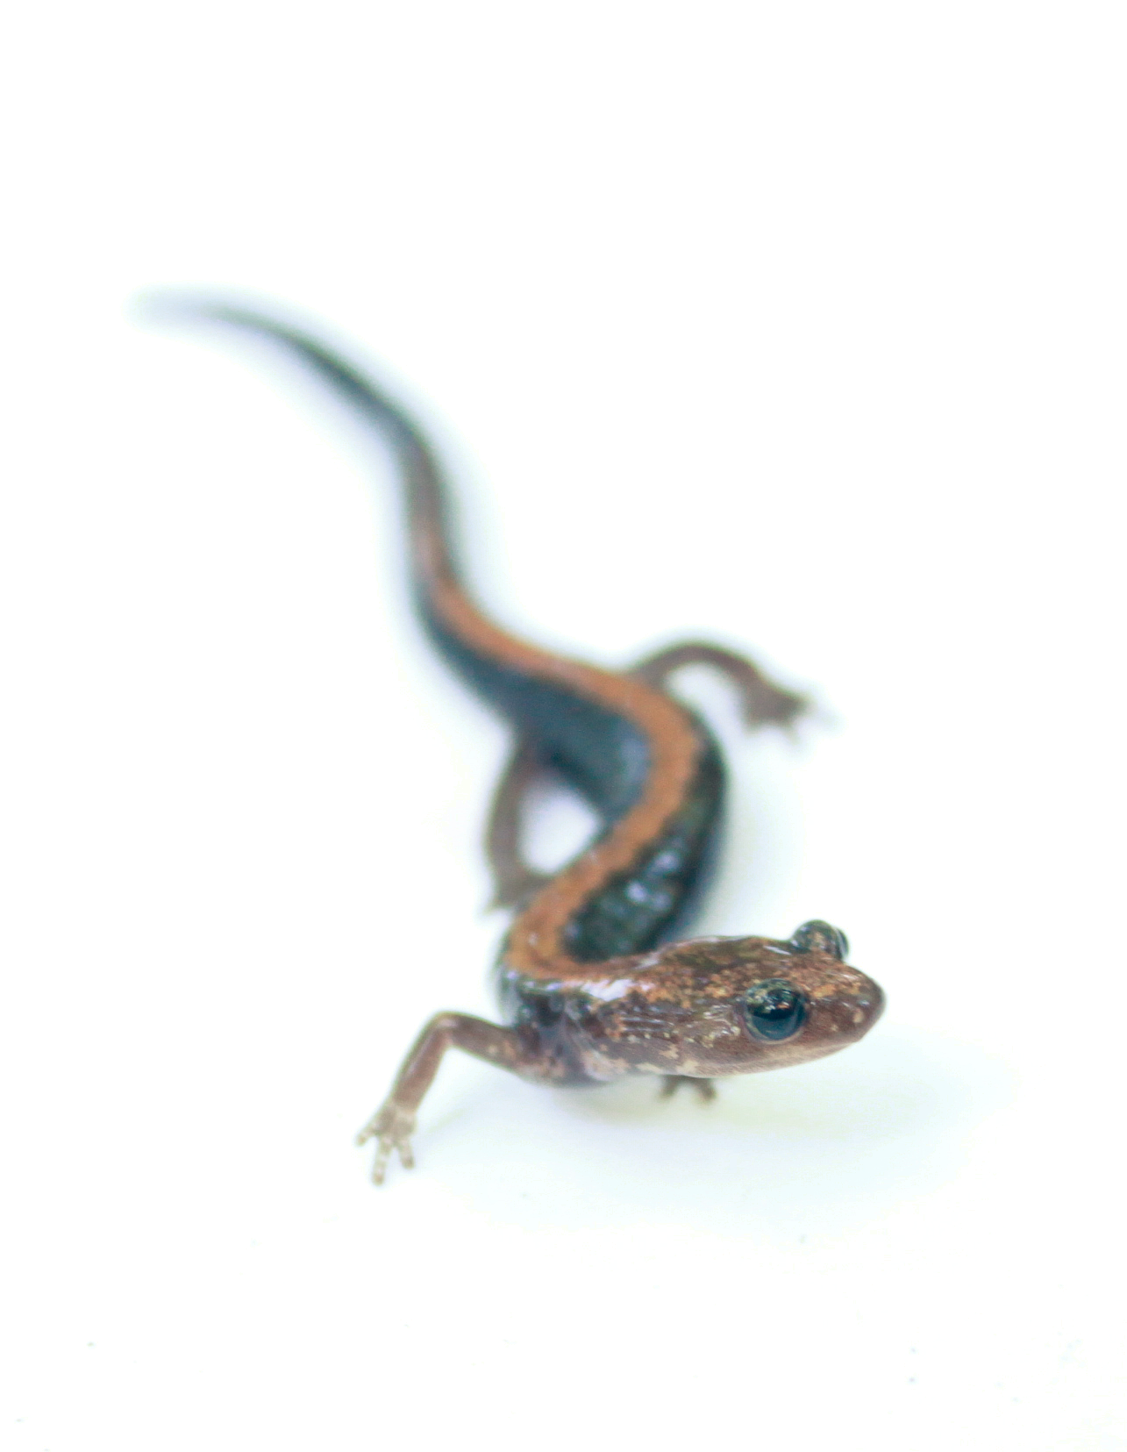
Challenges
Tree construction
insufficient data to resolve tree
multiple sequence alignment
ggplot2
so hard

Slide 13
Next steps…
Resolve the tree
Generalize my findings
simulated tree, simulated IUCN rankings
Look at accumulation of ED in the phylogeny
impact of taxon sampling on ED and EDGE values

Slide 14
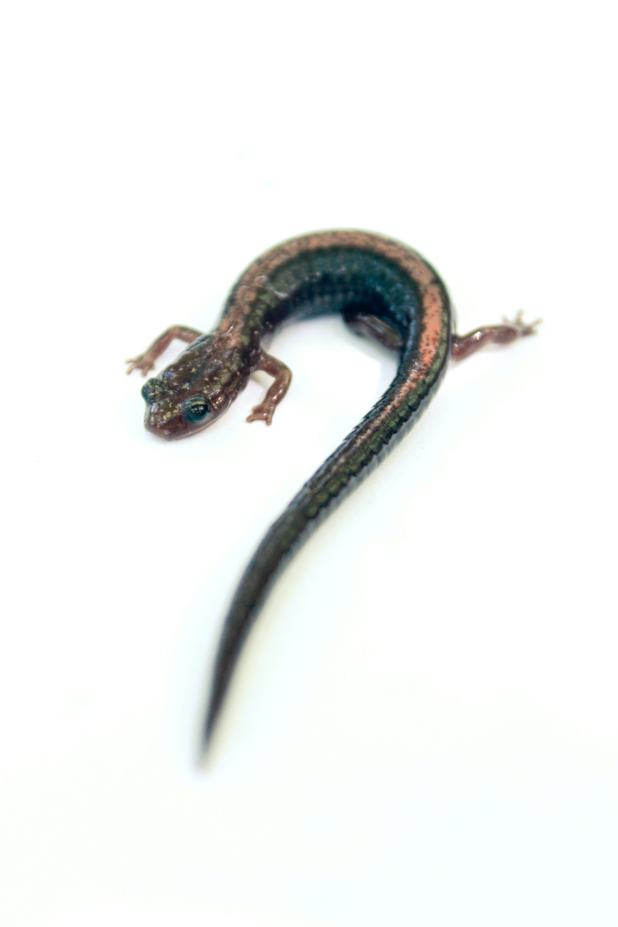
Questions?

